Slide 1

Understanding the EPC Strategy
in Today’s Market
A Presentation to GNOBR
January 29th, 2015

Slide 2
Overview
Safety Moment
Factors Affecting our Project Environment
The Contracting Dilemma
The EPC contract and its ‘pro et contra’
Keys to Success
Questions

Slide 3

Safety Moment
Situational Awareness is simply “knowing what is going on around you.” It is being aware of your surroundings outside of your current focus i.e. peripheral vision.
One of the greatest threats to situational awareness is the fixation or preoccupation of thoughts other than the main task at hand.
Another is the myth of multitasking where we believe that we can perform multiple tasks simultaneously. Conversely, studies show that attempting to multitask slows down the brains ability to process thought due to multiple start and stops.

Slide 4

Factors Affecting our Project Environment
The Concept of Accelerated Change
  We are living in a period of exponential change that has never existed before.
  Digital power continues to increase exponentially and will continue to do so for the next 20 to 30 years i.e.
    Moore’s Law – computing power doubling every 18 months
    Fiber law – communicating power doubling every 9 months
    Disk Law – storage power doubling every 12 months
Intel’s HDMI PC Stick due out this year!!
    2Gb Ram, 32Gb Storage
    Turn any TV into a computer

Slide 5
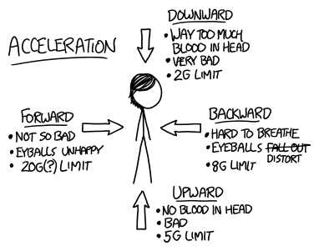
Factors Affecting our Project Environment
The Concept of Accelerated Change
  Why is this important to my project?
  What we did yesterday, last week, last month, last year, or the last 5 years that may have worked will not necessarily be successful tomorrow.
  Point: Do not lean entirely on yesteryear’s project execution strategy, tools, methods, etc.

Slide 6
Factors Affecting our Project Environment
The Litigious Workplace
Safety
Human Resources
Environmental
Cost
Schedule
Quality
Original Scope

Slide 7


Factors Affecting our Project Environment
The Litigious Workplace
  Contract negotiations can produce thick contracts and adversarial start to the project.
  Our past experiences and the current legal atmosphere makes both the owner and contractor highly risk averse.
  Point: Risk is inevitable, but how we shoulder and share that risk is up to the companies and project teams that execute the project. We can’t let our legal teams set the precedent.

Slide 8
Factors Affecting our Project Environment
Knowledge is no longer Power
  In 1597, Sir Francis Bacon wrote, “scientia potentia est”
  21st century technology has rewritten that theorem to say, “Scientia non est potentia.”
  An IDC study expects there to be 50x more data in 2020 than today available to the general population of industrialized countries.
  Why?
    Knowledge is a commodity now. Thanks to Siri.
    Knowledge spreads too fast for it to hold power for long.

Slide 9
Factors Affecting our Project Environment
Knowledge is no longer Power
  We can no longer think that we can execute a project leveraging power from some special knowledge that we “think” that we have.
  Gathering knowledge is no longer a problem – managing the knowledge is.
  Point: Restricting specific project knowledge will not aide in the success of the project.

Slide 10
The Contracting Dilemma
Horizontal versus Vertical Contracting
  Why we choose horizontally?
    We like/need options.
    We want to utilize our existing global supply chain agreements

Slide 11
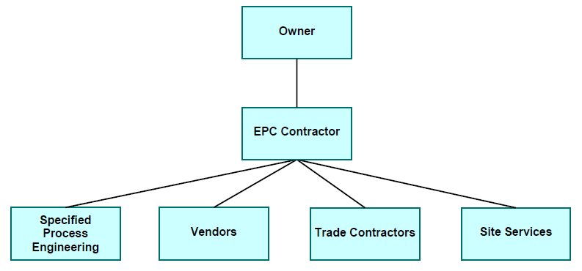
The Contracting Dilemma
Horizontal versus Vertical Contracting
  Why we choose vertically?
    Not enough resources to manage the project
    We prefer a single source of contact

Slide 12
The EPC contract and its ‘pro et contra’
The EPC Contract Proper
  So, we know that the EPC system of project delivery is an integration of design, engineering, procurement, and construction in one contract characterized by a single entity providing all the necessary services to design, engineer, and construct the project based upon the requirements established by the owner.
  This entity then can be:
    A joint venture, partnership or consortium.
    A construction firm subcontracting design, engineering, and procurement.
    A engineering firm subcontracting construction services.
    Or, one company performing design, engineering, and construction services.

Slide 13
The EPC contract and its ‘pro et contra’
The EPC Contract Pros & Cons
  Pros:
    Price Certainty
    Fastest track to completion
    Single point of contact
    Transfers majority of risks
  Cons:
    Contracted with only one entity
    Loss of Control due to Risk Transfer
    Potentially a higher Contract Price
    Scope must be settled early.

Slide 14
Keys to Success
Overcoming Accelerating Change
  Leverage the Change, don’t fight it!
  Learn to Unlearn
    The explicit and tacit dimensions of knowledge.
  Learn faster than your competitor
  Share your learnings rapidly within your organization
  Allow for agile experimentation & reflection

Slide 15
Keys to Success
Overcoming the Litigious Workplace
  Share the yoke (risks, information, communication)
  Hire a third party facilitator early on
  Promote team play and demote individual say
  Emphasize communication and not the mortar variety
  Make the project a “no assumptions” zone

Slide 16
Keys to Success
Overcoming the Powerless Knowledge
  Focus on knowledge sharing
  Focus on knowledge managing
  Promote team problem solving
  Don’t‘ fight the knowledge, leverage it!
  Emphasize harnessing the knowledge to profit all

Slide 17
Keys to Success
Overcoming the Contracting Dilemma
  Do we have the bandwidth to be horizontal?
  Are there current viable contracting entities for this project?
  Are our supply chain agreements competitive with the contracting entities?
  Can we let the past go?
  Do we have the latitude to choose based on the project elements?

Slide 18
Keys to Success
Consider choosing a partner

Slide 19
Keys to Success
To EPC or not to EPC
  Can we agree on technology and scope? Then decide early.
  Is there contracting entities out there we believe that we can hand the keys of the car to?
  Can you watch the project unfold without the control?
  Is this really, really a schedule driven project?
  Can we value the best risk managing contracting entity as much as cost, schedule, safety, and quality?

Slide 20
Conclusion
Comments, Questions

